Slide 1


CliMAF Earth System Model Evaluation Platform
Evaluating/comparing a set of simulations/models on Ciclad:
Demo / TP

Slide 2
Outline
C-ESM-EP Demo / Practicals
Running the C-ESM-EP demo for all components
Atlas Explorer as an exploratory tool:
Modify the input datasets:
Add/modify datasets (CMIP5 models or IGCM_OUT simulations)
Change the period and frequency
Setup your own CliMAF project
Control the reference
Using the Atlas Explorer parameter file
Overall parameters
Play with the dictionaries of the variables
Add new variables
Modify the plot parameters

Slide 3
1. Running The C-ESM-EP

Slide 4
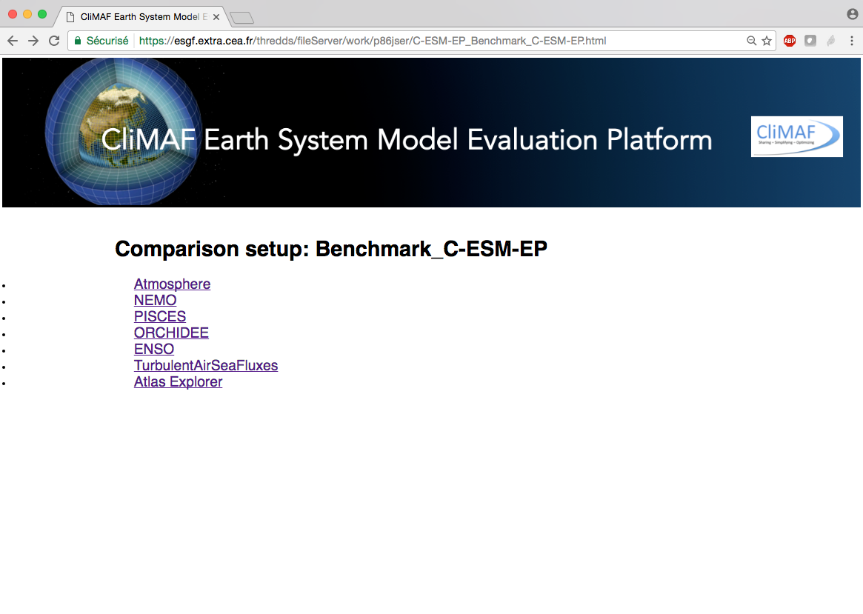
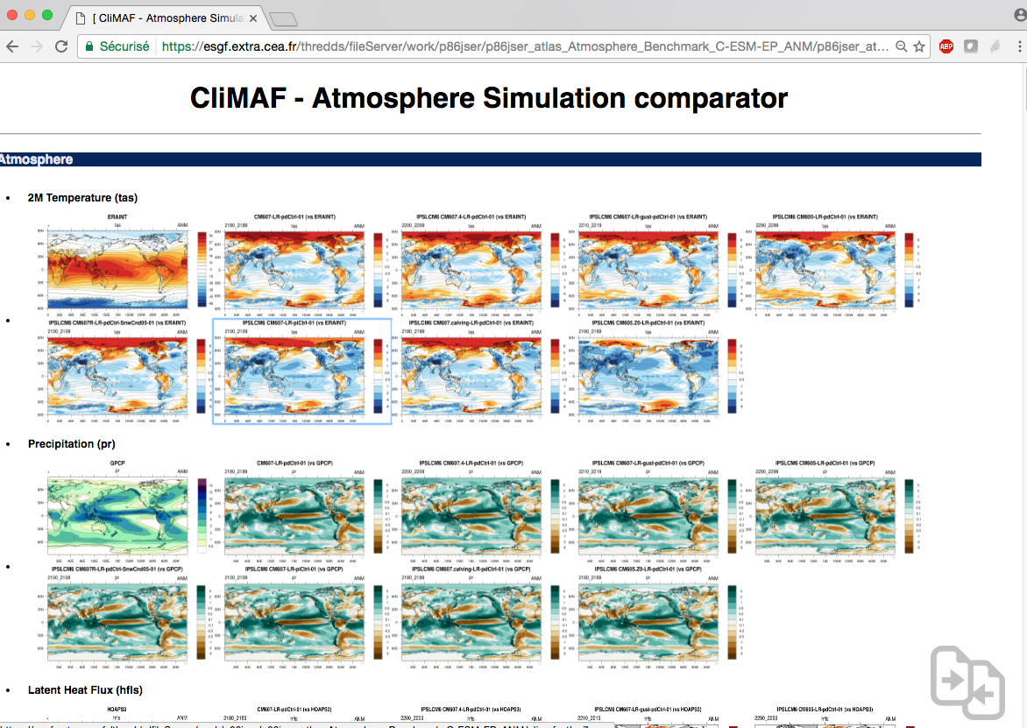
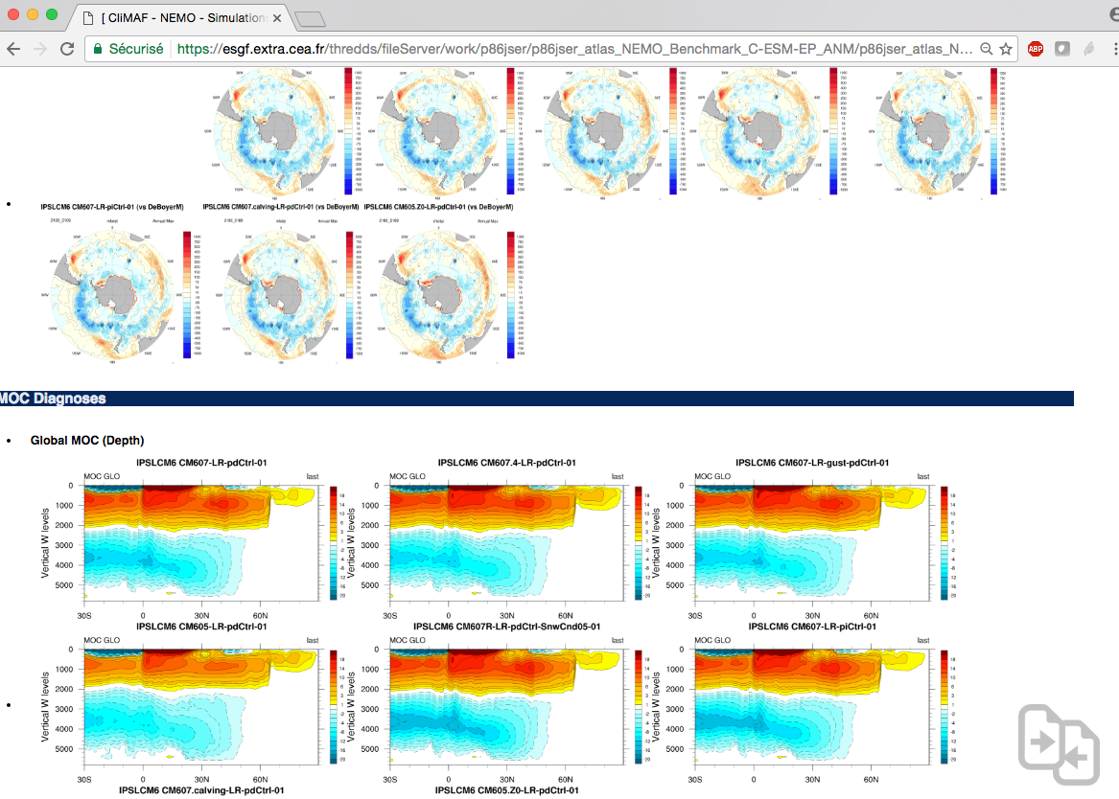
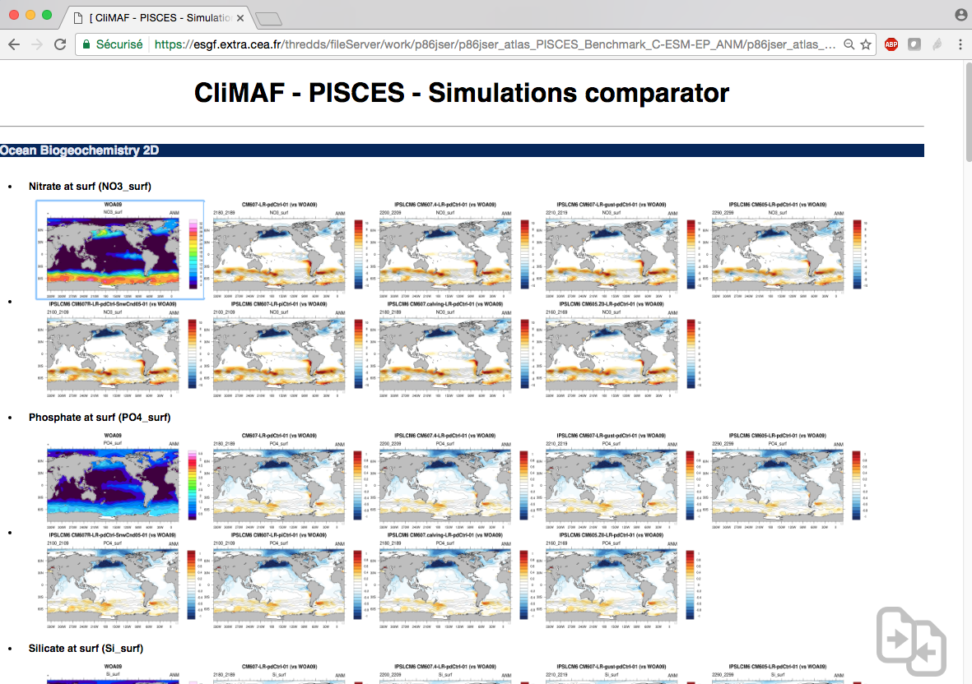
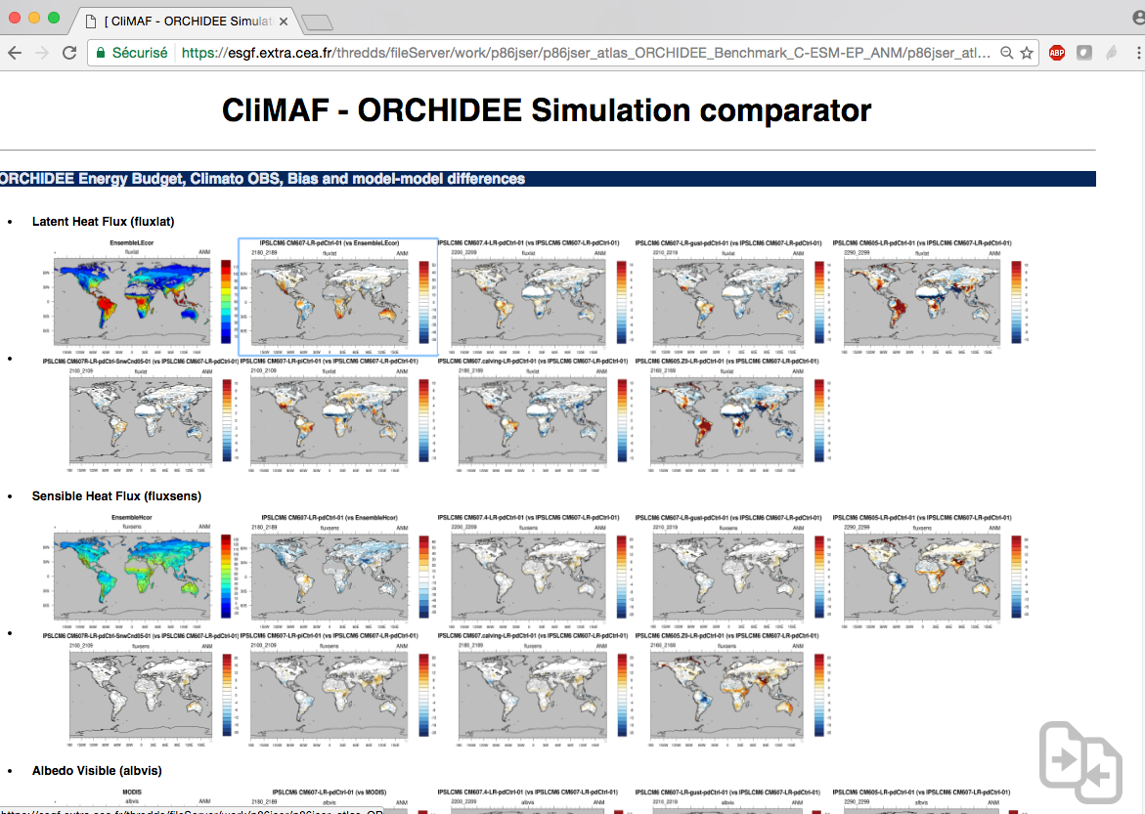
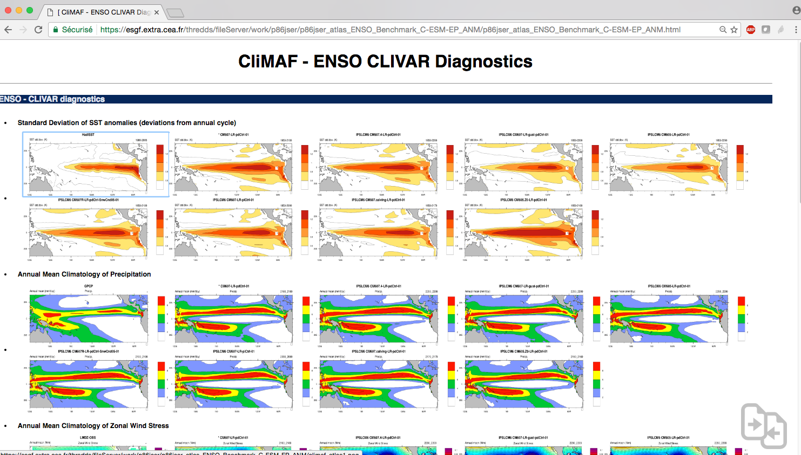
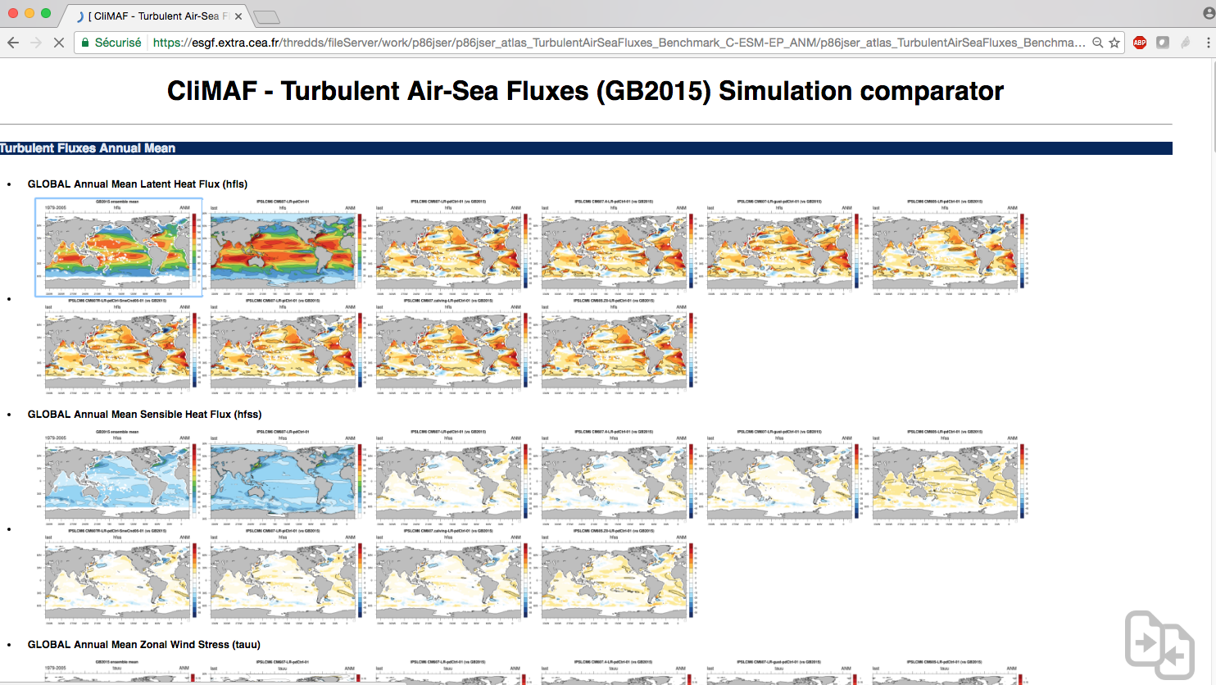
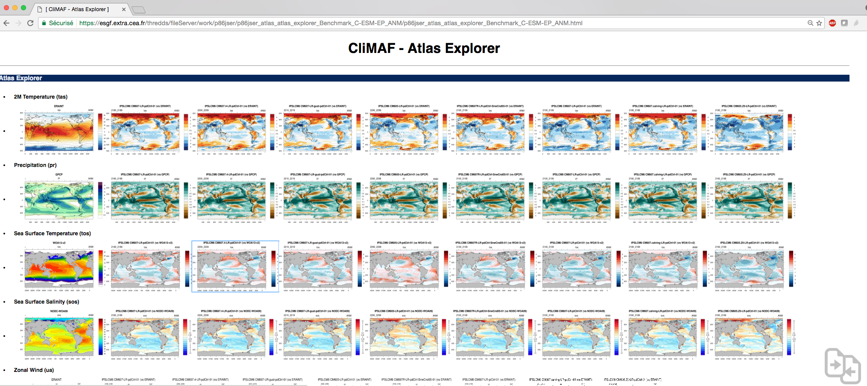

Slide 5
The C-ESM-EP in a nutshell
Prerequesite on your data
The data you want to work on is described by a CliMAF 'project' (data tree + variable names aliases)
The data has to be CF-compliant (norm on the metadata in the files, especially the dimensions)
We encourage working with CMIP variable names
No overlapping files in your data directories (do not have multiple files covering a common period for the same variable in the same data tree)

Slide 6
Getting started
Web server
Note: running the C-ESM-EP implies storing the results on a space that can be reached from the web.
Ciclad:
/prodigfs/ipslfs/dods/${username}
Curie:
/ccc/work/cont003/thredds/${username} #(if working on gencmip6)
/ccc/work/cont003/dods/public/${username} #(if working on dsm)
If you don't have an account on those spaces, send a request to:
Ciclad: svp-ciclad@ipsl.jussieu.fr
TGCC: hotline.tgcc@cea.fr

Slide 7
Getting started
Getting the C-ESM-EP sources folder
Ciclad:
sources=/home/jservon/C-ESM-EP/src
Curie:
sources=/ccc/cont003/home/dsm/p86jser/C-ESM-EP/src
For both Ciclad and Curie, we advise to work on /home to take advantage of the backup.

Slide 8
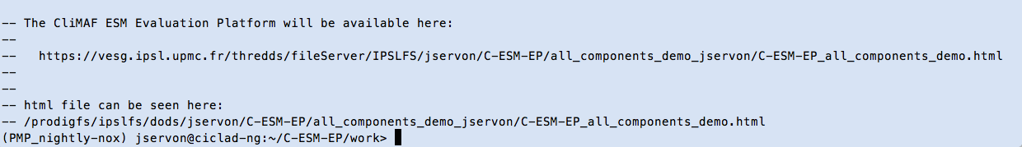
The C-ESM-EP in a nutshell
The quick way to use the C-ESM-EP on Ciclad
Copy the sources in a working directory:
cd my_working_directory
mkdir -p C-ESM-EP ; cd C-ESM-EP
cp –r ${sources} . ; cp –r src work
cd work
Setup your comparison:
cp -r comparison_example/ all_components_demo/
Run all the components together or just a subset:
python run_C-ESM-EP.py all_components_demo
See the results on the URL returned by run_C-ESM-EP.py
If you only want the URL, run:
python run_C-ESM-EP.py all_components_demo url

Slide 9
Getting started
Output directory for the results / portable atlas
On Ciclad, we can write directly on the dods server. Thus, the output directory is automatically set to:
CESMEP_OUT=/prodigfs/ipslfs/dods/${USER}
The result of the C-ESM-EP is meant to be portable, i.e. you can copy the top directory of your comparison on any space that you can access with a web browser and you will be able to read it.
The output tree is:
${CESMEP_OUT}/C-ESM-EP/${comparison}_user/
C-ESM-EP_${comparison}.html
${component}_${season}/
atlas_${component}_${comparison}_${season}.html
climaf_atlas*.png
In every ${component}_${season} directories you will find the html file of the atlas of the component, and the png images coming with it.

Slide 10
2. Playing with Atlas Explorer

Slide 11
Atlas Explorer
Goal - philosophy
Atlas Explorer is an easy and flexible way to produce an html page showing climatologies and difference maps (with a reference) on a set of datasets (simulations, models, different periods…).
The main goal of the Atlas Explorer is to provide the user with a set of predefined features to assess a variable (plotting parameters, default observational reference) while keeping a lot of control on the diagnostics from only one parameter file.
In this demo/practical, we will see how to control:
the input datasets (CMIP5 models, your simulations…)
The diagnostics (variables, region, season, customising the plots…)

Slide 12
Getting started with Atlas Explorer
Setup for an interactive session
Submit an interactive session with:
qsub –IV –q std
cd my_working_directory/C-ESM-EP/work
Setup a comparison directory to play with Atlas Explorer:
cp -r comparison_example/ toy_comparison/
cd toy_comparison
You're all set to start!

Slide 13
2.1 Add/modify datasets

Slide 14
2.1 Add/Modify the datasets
datasets_setup.py
Simulations – datasets

Slide 15
2.1 Add/Modify the datasets
datasets_setup.py
The datasets are specified in datasets_setup.py
The datasets are defined as python dictionaries containing the keywords/values pairs that are typically used by the CliMAF function ds() to access the data (but the variable).
The dictionaries can contain some custom control on the diagnostics (provide a season, a period and frequency specific to a diagnostic…).
Let's start by opening datasets_setup.py with your favourite editor:
vi datasets_setup.py
We will now learn how to add or modify the datasets in datasets_setup.py, using the pre-existing CliMAF projects (data access definitions).

Slide 16
2.1.1 CliMAF datasets
Standardized interface to access datasets
CliMAF provides a standardized way to access different data structures, defined with CliMAF projects, with a set of common/mandatory keys and possible specific keys to describe the data structure.
We access the datasets with the function ds() (shortcut to cdataset()) by providing pairs of keywords/values. Example (in CliMAF code):
dat = ds( project = 'CMIP5',
model = 'IPSL-CM5A-LR', experiment = 'historical',
simulation = 'r1i1p1', variable = 'tas',
frequency = 'monthly', period = '1980-2005'
)
Mandatory / specific
This functionality allows defining variable name aliases (potential scale/offset), so that you can work on all the different data structures with CMIP variables names and SI units.

Slide 17
2.1.1 The CliMAF projects
Getting access to the various data structures
In CliMAF, we get access to the datasets through CliMAF 'projects'.
A CliMAF project is defined by:
a pattern to access the data
a set of keywords that define the dataset (path + filename + variable)
a set of aliases (variables and frequency) between the names in the files and the CMIP standard names
Have a look at the documentation here:
http://climaf.readthedocs.io/en/latest/functions_data.html?highlight=cproject
And/or look at the examples (projects already defined in CliMAF) in the CliMAF version used for the C-ESM-EP:
/home/jservon/Evaluation/CliMAF/climaf_installs/climaf_1.0.3_CESMEP/climaf/projects
The igcm_out.py project file is a good example.

Slide 18
2.1.1 The 'CMIP5' CliMAF project
Example with the 'CMIP5' data structure
If you set this in datasets_setup.py:
models = [
dict(
project = 'CMIP5',
model = 'IPSL-CM5A-LR',
experiment = 'historical',
simulation = 'r1i1p1',
frequency = 'monthly',
period = '1980-2005'
)
]
You will make use of this pattern:
/prodigfs/project/CMIP5/output/*/${model}/${experiment}/${frequency}/
${realm}/${table}/${simulation}/${version}/${variable}/
${variable}_${table}_${model}_${experiment}_${simulation}_${period}.nc
To access this file
/prodigfs/project/CMIP5/output/IPSL/IPSL-CM5A-LR/historical/mon/
atmos/Amon/r1i1p1/latest/tas/
tas_Amon_IPSL-CM5A-LR_historical_r1i1p1_185001-200512.nc

Slide 19
2.1.1 The 'CMIP5' CliMAF project
Example with the 'CMIP5' data structure
The available keys and default values are:
model = no default
experiment = 'historical'
realm = '*'
table = '*'
simulation = 'r1i1p1'
version = 'last'
frequency = 'monthly'
period = no default
You need to define model and period.
Frequency='seasonal' is not available on project CMIP5.

Slide 20
2.1.1 The 'IGCM_OUT' project
Example with the 'IGCM_OUT' data structure
The 'IGCM_OUT' CliMAF project provides access to the data structure of the libIGCM model outputs, like LMDz, ORCHIDEE, NEMO, PISCES (and subsequently, LMDZ-OR, and IPSLCM models)
Here is a typical example of an IGCM_OUT dataset definition:
models = [
dict(project = 'IGCM_OUT',
root = '/ccc/store/cont003/thredds',
login = 'p86caub',
model = 'IPSLCM6',
simulation = 'CM605-LR-pdCtrl01',
frequency = 'seasonal',
clim_period = '2020_2029'
)
]

Slide 21
2.1.1 The 'IGCM_OUT' project
Example with the 'IGCM_OUT' data structure
CliMAF is searching your file among those patterns:
${root}/${login}[/IGCM_OUT]/${model}/${status}/${experiment}/
${simulation}/${DIR}/${OUT}/${ave_length}/
${simulation}_YYYYMMDD_YYYYMMDD_${frequency}_${variable}.nc
${root}/${login}[/IGCM_OUT]/${model}/${status}/${experiment}/${simulation}/${DIR}/${OUT}/${frequency}${clim_period_length}/
${simulation}_${frequency}_${clim_period}_1M_${variable}.nc

Slide 22
1.2.2/ project IGCM_OUT
Available keys
The available keys and default values are:
- root = '/ccc/store/cont003/thredds' # path (without the login)
# to the top of the IGCM_OUT tree
- login = '*' # login of the producer of the simulation
- model = '*' # explicit
- experiment = '*' # piControl, historical, amip...
- status = '*' # DEVT, PROD, TEST
- simulation = '*' # name of the numerical simulation
# (JobName in the IGCM syntax)
- DIR = '*' # ATM, OCE, SRF...
- OUT = 'Analyse' # or 'Output'
- frequency = 'monthly' # daily, annual_cycle (equivalent to 'seasonal')
- ave_length = 'MO' # MO, DA (optionnal, but can reduce the
# duration of the localization by ds() )
- period = 'fx' # explicit
- clim_period = '????_????' # explicit
- clim_period_length = '' # can be set to '_50Y' or '_100Y' to access
# the annual cycles averaged over 50yr long
# or 100yr long periods

Slide 23
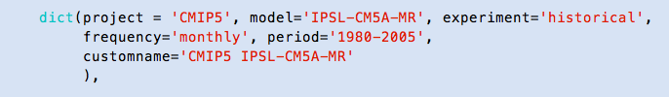
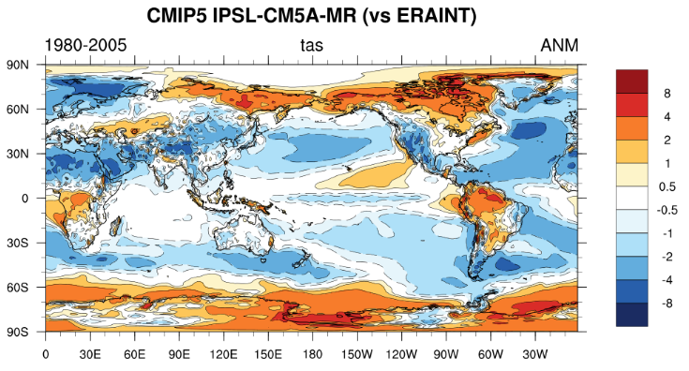
2.1.1 Name in the plot
Bonus: provide a customname to be used in the plots
Customname: you can provide a customname in the dataset dictionary that will be used in the plots

Slide 24
2.1.1 Exercise
Add / modify the datasets
Using the example, add another CMIP5 model and another IGCM_OUT simulation.
Then, run Atlas Explorer:
./job_C-ESM-EP.sh AtlasExplorer
See the results on the address at the end of the execution.

Slide 25
2.1.1 Debugging
Tracking down the errors
The C-ESM-EP has a 'safe_mode' that returns an empty (white) image when it doesn't successfully produce the plot (by default).
You can track down the origin of the error by setting 'safe_mode'=False in the associated parameter file in:
vi toy_comparison/AtlasExplorer/params_AtlasExplorer.py
Also ensure that you set verbose='debug' so that CliMAF will write what it's doing (and the details of the error).

Slide 26
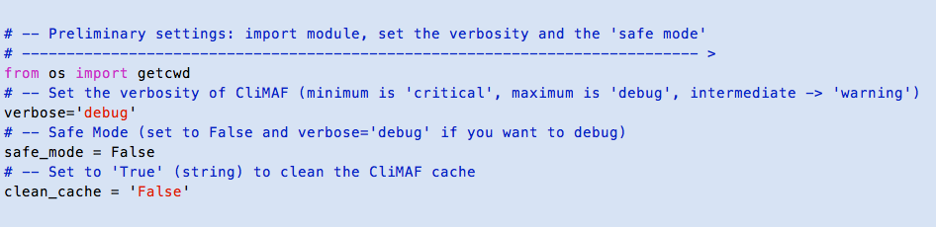
2.1.1 Debugging
Tracking down the errors
Example (from a params_AtlasExplorer.py file:

Slide 27
2.1.2 Control the period
Period selection in brief in CMIP5 and IGCM_OUT
The C-ESM-EP essentially works on 'monthly' and 'seasonal' datasets.
With the 'monthly' datasets, CliMAF can perform a smart period selection on the available netcdf files.
With the 'seasonal' datasets, CliMAF only selects an existing seasonal cycle netcdf file. The C-ESM-EP, however, has a smart way to select the last/first seasonal cycle available.
Both CMIP5 and IGCM_OUT projects have monthly datasets.
Only IGCM_OUT (and the ref_climatos project) provides seasonal datasets.

Slide 28
2.1.2 Control the period
Period selection in the CMIP5 project
One of the great features of CliMAF is the automatic selection of the period provided by the user.
When you set frequency='monthly', you have to provide a period that will be extracted among the non-overlapping netcdf files in the targeted directory.
For instance, this dataset definition:
dict(project = 'CMIP5', model = 'IPSL-CM5A-LR',
experiment = 'historical', simulation = 'r1i1p1',
frequency = 'monthly', period = '1980-2005')
Will extract the period 1980-2005 from this file found in the archive:
/prodigfs/project/CMIP5/output/IPSL/IPSL-CM5A-LR/historical/mon/atmos/Amon/r1i1p1/latest/tas/
tas_Amon_IPSL-CM5A-LR_historical_r1i1p1_185001-200512.nc

Slide 29
2.1.2 Control the period and frequency
Period selection in IGCM_OUT
In the IGCM_OUT project, you will have the same behaviour as for the CMIP5 project with frequency='monthly' (fundamental CliMAF functionality).
By default, it will target the 'TS_MO' time series files created by the post-processing (one variable per file with all time steps).
If you want to get the data from the 'Output/MO' files, add OUT='Output' to the list of arguments :
dict(project = 'IGCM_OUT', root = '/ccc/store/cont003/thredds',
login = 'p86caub', model = 'IPSLCM6',
simulation = 'CM605-LR-pdCtrl01'
frequency = 'monthly', OUT='Output', period = '2020_2029')

Slide 30
2.1.2 Control the period and frequency
Working with pre-computed annual cycles IGCM_OUT 'SE'
The IGCM_OUT project allows access to the pre-computed '/Analyse/SE' annual cycles provided as a post-treatment.
We access the SE with frequency='seasonal'.
Because we don't do period selection on annual cycles, the 'period' argument is automatically set to 'fx' (for 'fixed field').
Instead, we use 'clim_period' that can be:
an explicit character string providing the pre-existing period
'last_SE' or 'first_SE' to get the last/first available annual cycle of the simulation
dict(project = 'IGCM_OUT', root = '/ccc/store/cont003/thredds',
login = 'p86caub', model = 'IPSLCM6',
simulation = 'CM605-LR-pdCtrl01'
frequency = 'seasonal', clim_period = '2020_2029'),
dict(project = 'IGCM_OUT', root = '/ccc/store/cont003/thredds',
login = 'p86caub', model = 'IPSLCM6',
simulation = 'CM605-LR-pdCtrl01'
frequency = 'seasonal', clim_period = 'last_SE')

Slide 31
2.1.2 clim_period and ts_period
Period for the clim. and the time series C-ESM-EP diagnostics
The C-ESM-EP is composed of 'climatology diagnostics' (like bias maps) and 'time series diagnostics' (like the AMOC index or ENSO diagnostics).
Because of this, the user might want to provide one period for the climatologies, and one for the time series.
The diagnostics of the Atlas Explorer are only 'climatology diagnostics'. We will describe how to handle the 'time series diagnostics' also here, but it will not be applicable to the Atlas Explorer.

Slide 32
2.1.2 clim_period and ts_period
Period for the clim. and the time series C-ESM-EP diagnostics
Trivial case
If the user sets frequency='monthly' and provides a 'period', the C-ESM-EP will use this period for both the time series diagnostics and the climatologies.
Separate control of the clim and ts period
The C-ESM-EP has a specific functionality that adds to the CliMAF data access and allows controlling the period for the different diagnostics:
clim_period for the climatological diagnostics
ts_period for the time series diagnostics

Slide 33
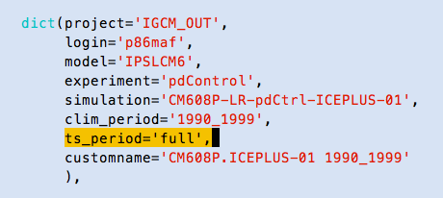
2.1.2 ts_period
Period for the time series diagnostics
If the user provides a ts_period the C-ESM-EP will automatically set frequency='monthly' for the diagnostics labeled 'TS'.
ts_period takes the following values:
an explicit period (ex: '1980-2005', '198001_200012', '20000101-20051231')
last_XXY / first_XXY to extract the last/first XX years available
'full' to get the whole available period

Slide 34
2.1.2 clim_period
Period for the climatology (notably for Atlas Explorer)
If the user provides a clim_period, we have two cases:
Case 1: frequency='seasonal'
In this case (only for IGCM_OUT), CliMAF will get the 'SE' files.
Possible values (as said previously):
an explicit character string providing the pre-existing period
'last_SE' or 'first_SE' to get the last/first available annual cycle of the simulation
Case 2: frequency='monthly'
If the user provides a 'clim_period' with frequency='monthly', the C-ESM-EP will use the value of clim_period as a 'period'. CliMAF will then handle the period extraction and the C-ESM-EP will compute the climatology over this period.
Possible values:
an explicit period (ex: '1980-2005', '198001_200012', '20000101-20051231')
last_XXY / first_XXY to extract the last/first XX years available
'full' to get the whole available period

Slide 35
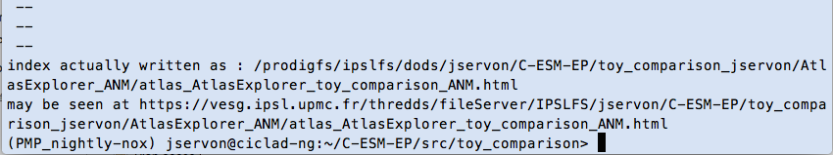
2.1.2 Exercise
Change the period in Atlas Explorer
Using the example, add other periods of the same CMIP5 model and IGCM_OUT simulation to the list of datasets.
Then, run Atlas Explorer:
./job_C-ESM-EP.sh AtlasExplorer
See the results on the address at the end of the execution.

Slide 36
2.1.3 Add your own project
Access your own datasets
You can easily access your own datasets by creating a CliMAF project directly in datasets_setup.py.
You will find an example in datasets_setup.py with a 'CMIP5_bis' project (same as next slide).
The minimum you have to do is a 'cproject' and a 'dataloc'.
You will also see how to use cdef() (define default values) and cfreqs() (aliases for the frequency names).
You're also invited to look at the CliMAF documentation for the use of those functions, and get some inspiration from the CliMAF projects in:
/home/jservon/Evaluation/CliMAF/climaf_installs/climaf_1.0.3_CESMEP/climaf/projects

Slide 37
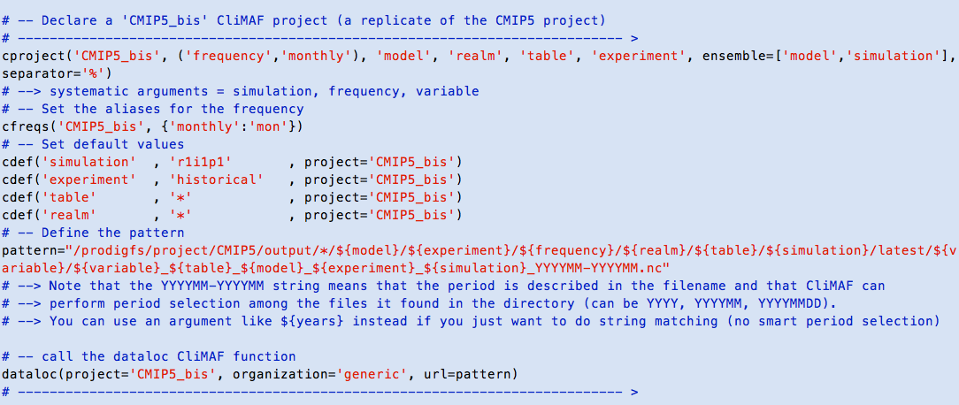
2.1.3 Add your own project
Add access to your own data structure

Slide 38
2.1.4 Choose the reference
Reference used for the difference maps
The goal of Atlas Explorer is to do difference maps between a set of datasets (specified in the 'models' list) and a reference, controlled with 'reference' in datasets_setup.py (also in the parameter files for custom control).
The 'default' reference provides access to a set of pre-defined references (observations, reanalyses) for each variable. This is done via the CliMAF function variable2reference() (not seen by the user) that returns a dataset dictionary defining the reference dataset for the chosen variable.
# -- Set the reference against which we plot the diagnostics
# ---------------------------------------------------------------------------- >
# -- -> 'default' uses variable2reference to point to a default
# -- reference dataset (obs and reanalyses)
# -- -> you can set reference to a dictionary that will point any other
# -- climaf dataset
# -- For instance, you can set it to models[0] if you want to see the
# -- differences relative to the first simulation of the list 'models'
reference = 'default'

Slide 39
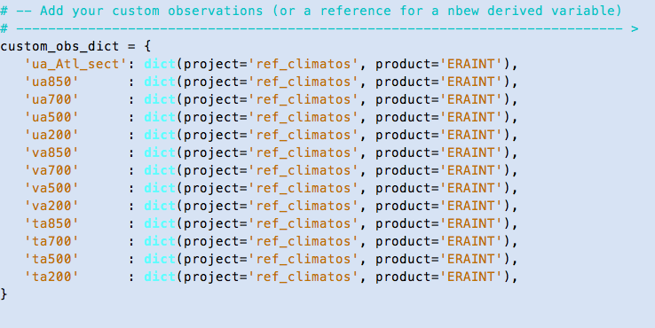
2.1.4 Add your reference
Adding user reference to the default references
It is possible to add your own references (if described by a CliMAF project) with custom_obs_dict (either from datasets_setup.py or the parameter file).
It is particularly useful if you defined new variables, or want to change the reference that is provided by default.
Example: specifying the ERAINT reference of the project ref_climatos for a list of variables:

Slide 40
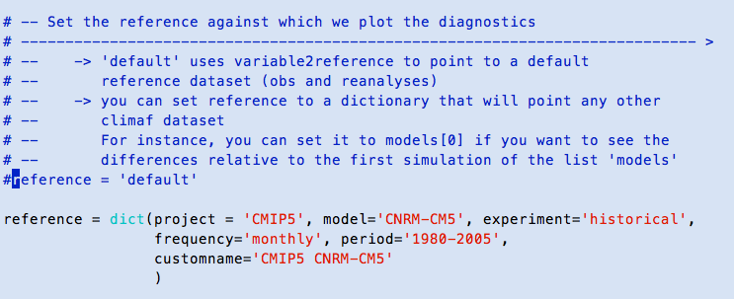
2.1.4 Difference with a simulation
Use a simulation dataset as the reference
Atlas Explorer also allows to do differences between a reference simulation and the 'models' datasets.
For this, you simply provide a simulation dataset dictionary to reference:

Slide 41
2.1.4 Difference with a simulation
Use a simulation dataset as the reference
Note 1
CliMAF offers a set of pre-defined plot parameters, depending on the 'context': full_field (for a climatology), 'bias', and 'model_model' for model-model differences. The C-ESM-EP automatically defines the context by analysing the input datasets.
In that case, CliMAF will use the pre-defined plot parameters for the 'model_model' differences (and not the 'bias' differences).
(more details in section 2.2.4)
Note 2
Much of our climate science consists in doing climatologies and differences…This functionality provides a huge amount of possibilities:
Differences of targeted periods of a simulation relative to the climatology of this simulation
Evolution of a simulation relative to the first month/year
Differences of a set of simulations with a reference model version
…

Slide 42
2.2 AtlasExplorer parameter file

Slide 43
2.2 Atlas Explorer parameter file
Using the parameter file to control the diagnostics
The content of the Atlas Explorer (and the C-ESM-EP components) is widely controlled from the parameter file:
AtlasExplorer/params_AtlasExplorer.py
In this section we will learn how to use it.

Slide 44
2.2.1 Overall parameters
General control of the Atlas Explorer
The following parameters control the execution:
# -- Set the verbosity of CliMAF (minimum is 'critical', maximum is 'debug', intermediate -> 'warning')
verbose='debug'
# -- Safe Mode (set to False and verbose='debug' if you want to debug)
safe_mode = False
# -- Set to 'True' (string) to clean the CliMAF cache
clean_cache = 'False'

Slide 45
2.2.1 Overall parameters
General control of the Atlas Explorer
Those parameters are general values for the diagnostics of the atlas:
# -- Set the reference against which we plot the diagnostics
# ---------------------------------------------------------------------------- >
# -- -> 'default' uses variable2reference to point to a default
# -- reference dataset (obs and reanalyses)
# -- -> you can set reference to a dictionary that will point any other
# -- climaf dataset
# -- For instance, you can set it to models[0] if you want to see the
# -- differences relative to the first simulation of the list 'models'
reference = 'default'
# -- Set the overall season, region and geographical domain
# --> season, region and domain do not overwrite the values that are pre-defined with some diagnostics
# ---------------------------------------------------------------------------- >
season = 'ANM' # -> Choose among all the possible values taken by clim_average (see help(clim_average)) like JFM, December,...
proj = 'GLOB' # -> Set to a value taken by the argument 'proj' of plot(): GLOB, NH, SH, NH20, SH30...
#domain = dict(lonmin=0, lonmax=360, latmin=-30, latmax=30) # -> set domain = dict(lonmin=X1, lonmax=X2, latmin=Y1, latmax=Y2)
domain = {}

Slide 46
2.2.2 atlas_explorer_variables
Provide a variable with additionnal features
One of the goals of Atlas Explorer is to provide the user with an easy control of the scientific content of the atlas.
Each line of the html page is an element of the atlas_explorer_variables list in the params_AtlasExplorer.py file.

Slide 47
2.2.2 atlas_explorer_variables
Provide a variable with additionnal features
Variables (seasons, projections, domains…)

Slide 48
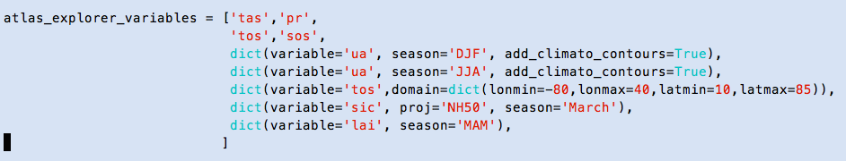
2.2.2 atlas_explorer_variables
Provide a variable with additionnal features
From the atlas_explorer_variables python list, the user can provide:
a variable name as a character string
=> uses the overall plot parameters + the pre-defined plot parameters for each variable
A dictionary containing specific instructions for this line of plot

Slide 49
2.2.2 atlas_explorer_variables
Provide a variable with additionnal features
Here is the list of arguments that you can control from the dictionary of a variable:
All arguments that the 'plot' CliMAF function can take:
http://climaf.readthedocs.io/en/latest/scripts/plot.html
proj: the projection used (GLOB, NH20, SH60…)
contours: add contours
colors, min, max, delta: control the color isolines
color: an NCL color palette
…
See next slide

Slide 50
2.2.2 atlas_explorer_variables
Provide a variable with additionnal features
And arguments that are specific to the C-ESM-EP:
season: explicit (see clim_average in CliMAF doc)
domain: a geographical domain (example in params_AtlasExplorer.py)
spatial_anomalies: True or False (remove the mean of the field)
cdogrid: provide a specific CDO grid to regrid both model and reference
regrid_option: a specific CDO regridding method
zonmean_variable: specify that the variable will be shown as zonal means (for new variables created from the param file)
add_climato_contours: True/False

Slide 51
2.2.3 The variables
How can I add my own new variable?
Now I would like to work with a new variable (that is not already used in the various parameter files of all the different components).
Case 1
If path/filename targeted by the CliMAF project you are using contains explicitly the variable name (as for CMIP5), you can access it rightaway.
Ex with 'tas':
tas_Amon_IPSL-CM5A-LR_historical_r1i1p1_185001-200512.nc
Case 2
If not, like in the IGCM_OUT project for the 'SE' files, the file contains multiple variables and the file name contains a specific character string.
Example with 'tas' found in the 'histmth' file:
CM605-LR-pdCtrl01_SE_2000_2009_1M_histmth.nc
Go to next slide

Slide 52
2.2.3 The variables
Add my variable + create an alias to the CMIP name
You then need to tell CliMAF that it will find the variable 'tas' in the file containing 'histmth' (filenameVar='histmth') by creating an alias with the CliMAF function calias():
calias('IGCM_OUT','tas','t2m', filenameVar='histmth')
We encourage the users to use CMIP variable names to facilitate the sharing of atlases (and crossing the different CliMAF projects in the same atlas).
That's why at the same time, we create an alias to tell CliMAF that the variable 'tas' (second argument) is actually the variable 't2m' (third argument) in the IGCM_OUT project (first argument).
You can also add a scaling and offset to this alias (CliMAF works with SI units):
calias("IGCM_OUT", 'tos', offset=273.15, filenameVar='grid_T')
calias("IGCM_OUT", 'sic', 'siconc', scale=100, filenameVar="icemod")

Slide 53
2.2.3 Creating a derived variable
Create a variable as the combination of variables
A 'derived variable' is a new variable obtained as the combination of existing variables (adding/substracting two variables, extract a PFT…).
The user can create his/her own derived variables from the parameter file.
Example:
derive('*','rstt','minus','rsdt','rsut')
… means that for all projects (first argument '*', the variable 'rstt' (second argument) is the substraction (application of the operator 'minus', third argument) between 'rsdt' and 'rsut'.
It is possible to add a scale and offset at that step.
Go to next slide…

Slide 54
2.2.3 Creating a derived variable
Create a variable as the combination of variables
For more details on derive(), please look at:
http://climaf.readthedocs.io/en/latest/functions_data.html?highlight=derive
The user can also create a new CliMAF operator if needed (if the operator is not already available, see the documentation), and/or use the truly powerful ccdo() operator to use any CDO operator.
For an explicit example, check the ORCHIDEE parameter file.

Slide 55
2.2.4 Plot parameters
Controlling the plot parameters per variable
As we've seen, with Atlas Explorer the user can control the plot parameters directly from the variable dictionary in atlas_explorer_variables.
If you want to modify the plot parameters for all your atlases (for each variable), across all components, you can do it in the custom_plot_params.py file in the main directory
(C-ESM-EP/work).
In this file you have the possibility to provide any argument of the CliMAF plot() function as a plot parameter for any targeted variable and context.

Slide 56
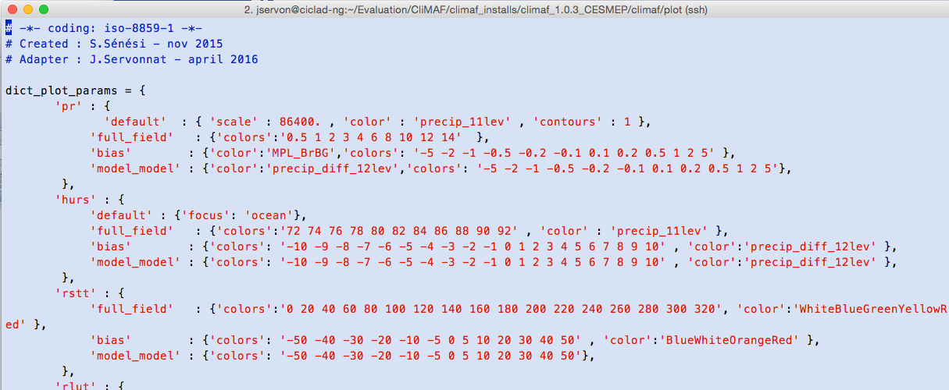
2.2.4 Plot parameters
Controlling the plot parameters per variable
Example:
Note: if the isolines in 'full_field' are provided with 'colors' (defined by hand… yes it's boring), the climatology of the reference can be over-imposed to the bias maps as contours.

Slide 57
2.2.4 Plot parameters
Controlling the plot parameters per variable
There are three 'contexts':
'full_field' (for a climatology)
'bias' for a model-obs difference
'model_model' for model-model differences
The C-ESM-EP automatically determines the context by analysing the input datasets.
If you just want to modify something in the existing plot parameters (the isolines, the color palette…), copy the plot parameters of the variable from the CliMAF install in your custom_plot_params.py file:
/home/jservon/Evaluation/CliMAF/climaf_installs/climaf_1.0.3_CESMEP/climaf/plot
The content of the custom_plot_params.py file provides an example for the variable 'pr'.

Slide 58
The compareCompanion

Slide 59
The compareCompanion
Display a selection of figures on the fly
The various html pages can provide a lot of information and you might need to select a subset of them to focus on a particular question.
For this, the C-ESM-EP comes with an 'on-the-fly' tool to select a subset of plots, called the compareCompanion (P. Brockmann).

Slide 60
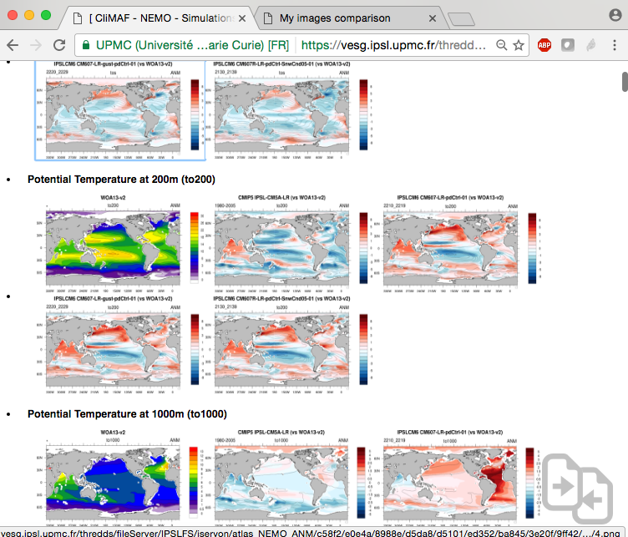
The compareCompanion
Display a selection of figures on the fly

Slide 61
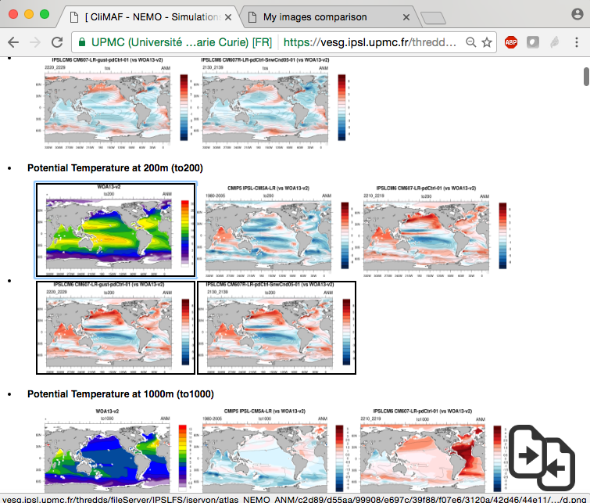
The compareCompanion
Select your figures with 's'
Select the images by putting the mouse over the plots and press 's' (for 'select')
A black line is drawn over the selected plots

Slide 62
The compareCompanion
Select your figures with 's'
Click on the bottom right icon…

Slide 63
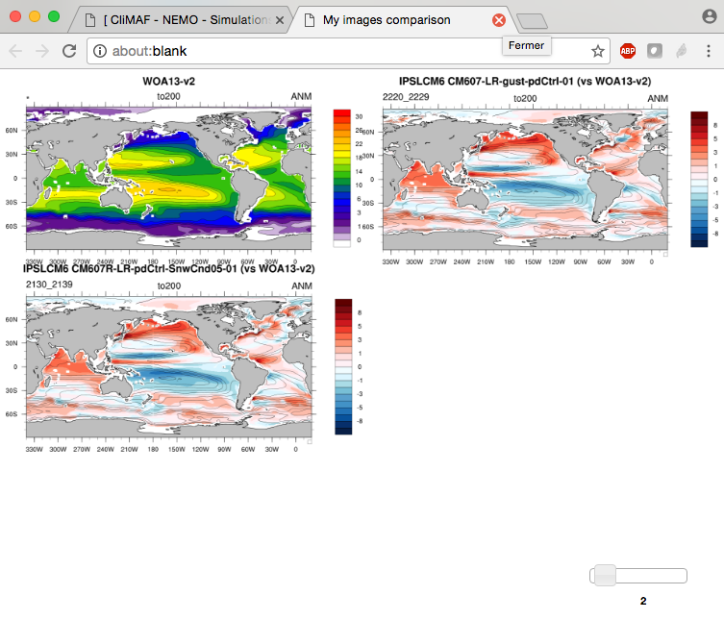
The compareCompanion
Display a selection of figures on the fly
Here is your selection of plots!
Control the number of columns with the slider…
And switch their positions by dragging the image you want at the position of your choice

Slide 64
The compareCompanion
Clear the selection
Clear the compareCompanion cache by pressing 'c' (for 'clear')…
… and restart with a new selection.

Slide 65
Questions? jerome.servonnat@lsce.ipsl.fr

Slide 66
The CliMAF Earth System Model Evaluation Platform, 2017
J. Servonnat, S. Sénési, L. Vignon, O. Marti, P. Brockmann, S. Denvil
Contributors:
F. Hourdin, I. Musat, M.P. Moine, E. Sanchez, M. Chevallier, R. Msadek, J. Deshayes, M. Van Coppenolle, C. Rousset, J. Mignot, J. Ghattas, P. Peylin, N. Vuichard, P. Cadule, A. Ducharne, F. Maignan, R. Séférian
Beta-testers:
O. Marti, J. Mignot, J. Deshayes, P. Braconnot, P. Sepulchre, M. Kageyama, S. Denvil, R. Séférian, A. Cozic
The authors would like to give special credit to A. Voldoire for showing the way for CliMAF, and to F. Hourdin and the LMDz team for the structure of the C-ESM-EP that is largely inspired from the LMDz evaluation atlas.

